Slide 1
Test time adaptation
杜云涛
2021.11.11

Slide 2
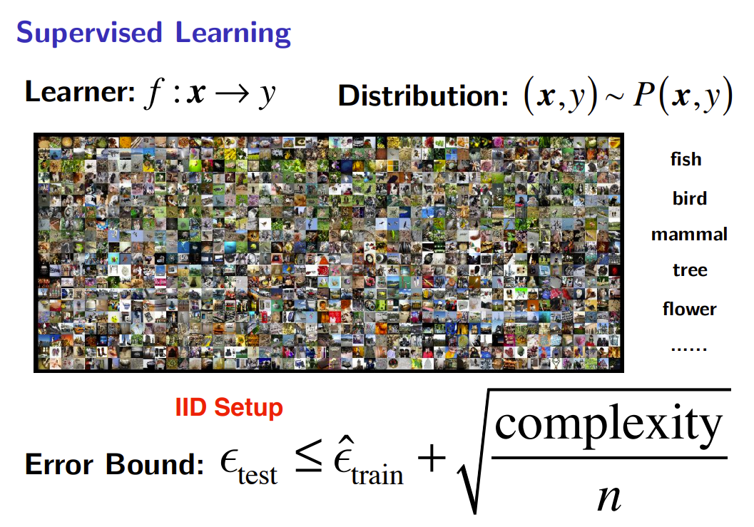

Slide 3
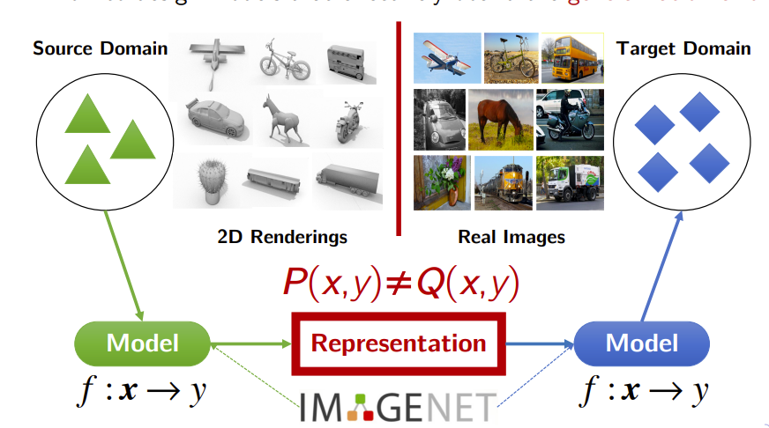
Transfer Learning

Slide 4
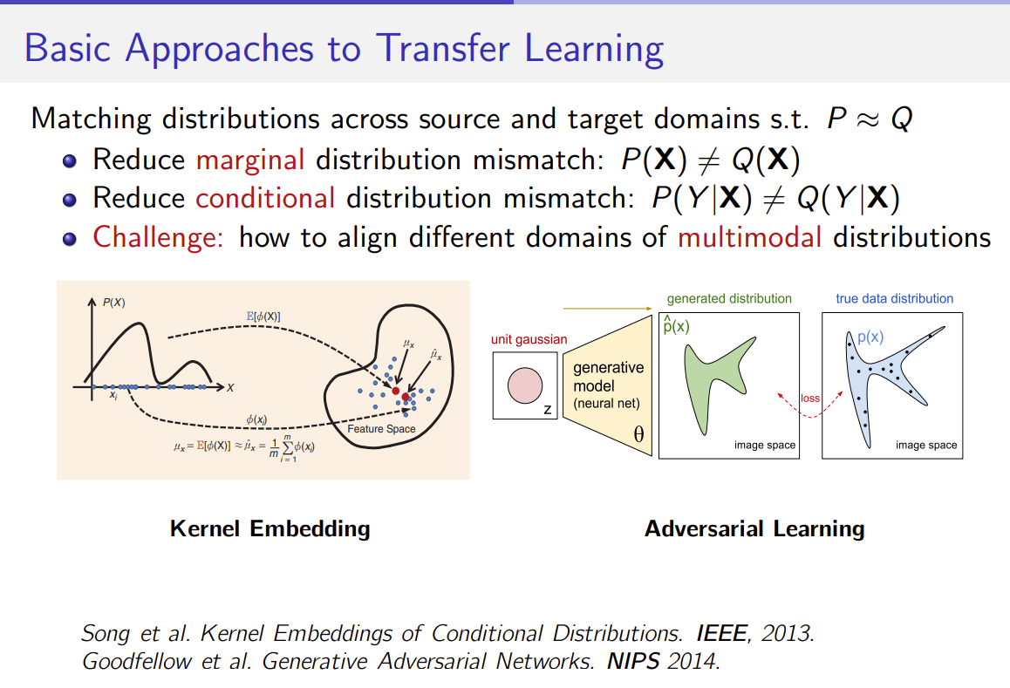

Slide 5
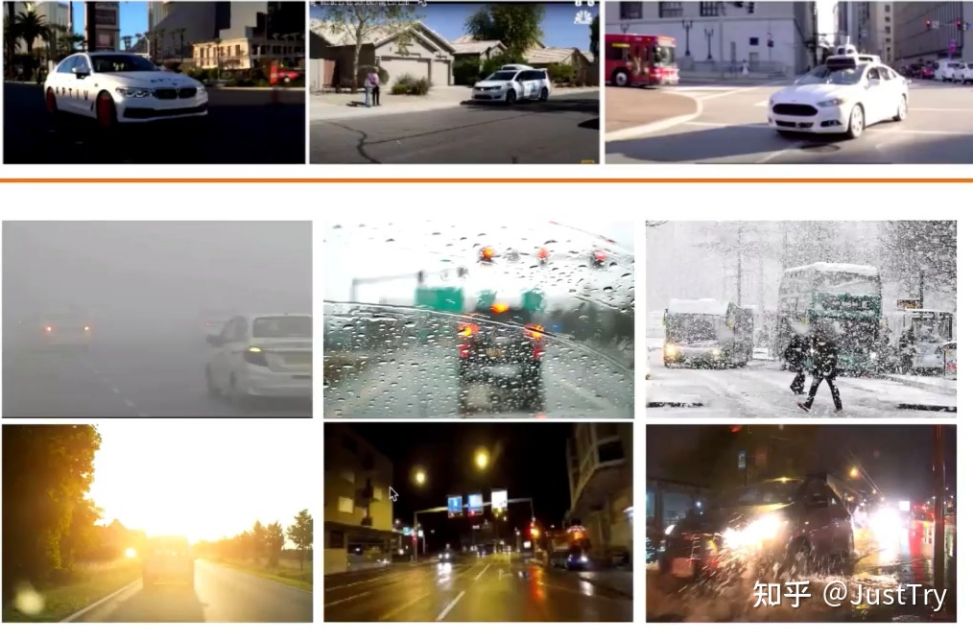
UDA范式梳理
源域(训练数据)
应用场景

Slide 6

UDA的局限：不能适应变化的应用场景
源域(训练数据)
应用场景

Slide 7
UDA vs DG
源域(训练数据)
应用场景
源域(训练数据)
应用场景

Slide 8
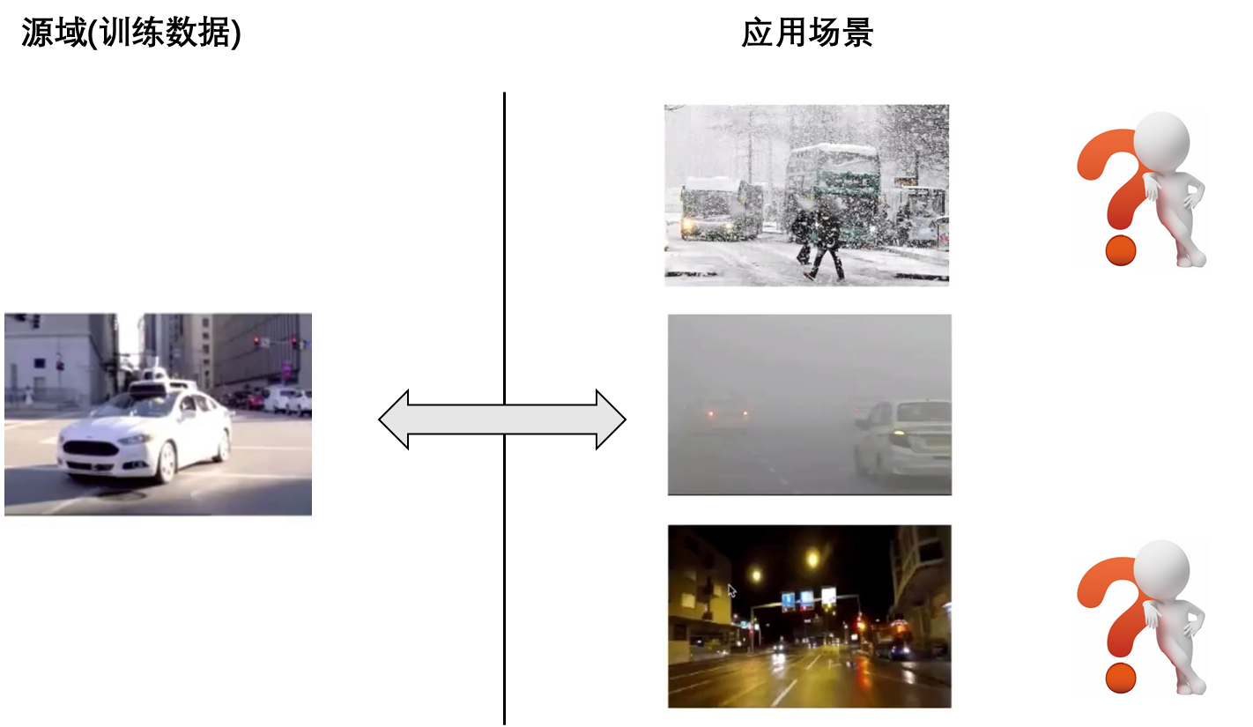
UDA的扩展：适应目标场景
将待测试/应用的场景或领域的数据融入到现有的模型中，从而可以更好地适应各种各样的应用场景。

Slide 9
ICML 2020: Test-Time Training with Self-Supervision for Generalization under Distribution Shifts
Yu Sun, Xiaolong Wang, Zhuang Liu, John Miller, Alexei A. Efros, Moritz Hardt
University of California, Berkeley, University of California
Motivation: 本文探索了一种新的泛化方法，它不预测分布的变化，而是在测试时从中学习
Hint: 在测试时给出的未标记的测试样本x给了我们一个关于它的分布的提示。
Method: 我们提出的测试时训练方法产生了一个基于单个测试样本x的自监督学习问题，在进行预测之前更新模型.

Slide 10


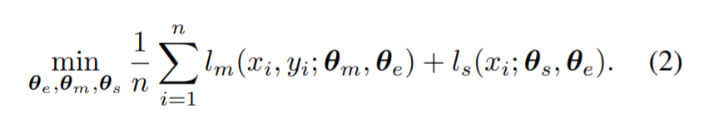





ICML 2020: Test-Time Training with Self-Supervision for Generalization under Distribution Shifts
shared feature extractor.
Training time
self-supervised task branch
task-specific parameters
（ ， ）
shared feature extractor.
Test-Time Training
旋转角度预测

Slide 11
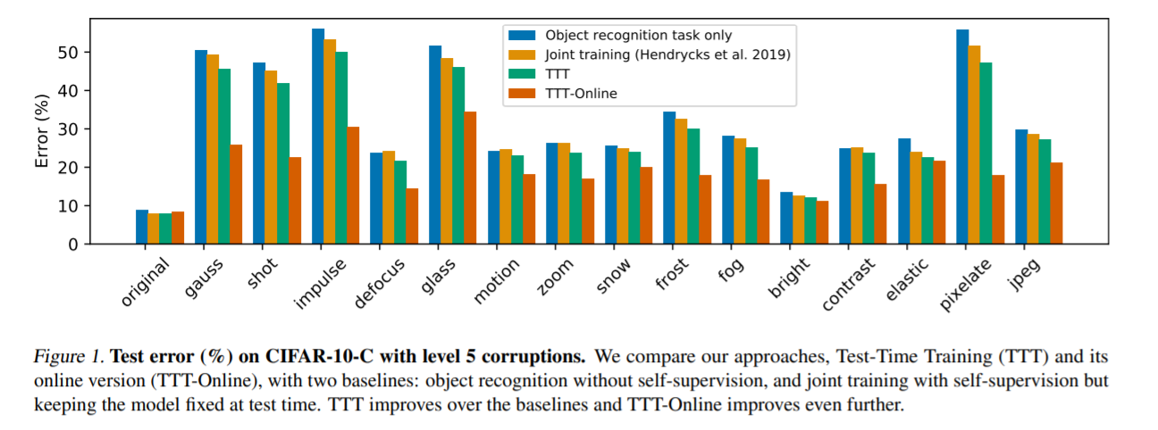
ICML 2020: Test-Time Training with Self-Supervision for Generalization under Distribution Shifts

Slide 12
ICML 2020: Test-Time Training with Self-Supervision for Generalization under Distribution Shifts
shared feature extractor.
Training time
self-supervised task branch
task-specific parameters
（ ， ）
shared feature extractor.
Test-Time Training
缺点：对模型的训练阶段有额外要求，不完全通用

Slide 13
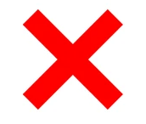
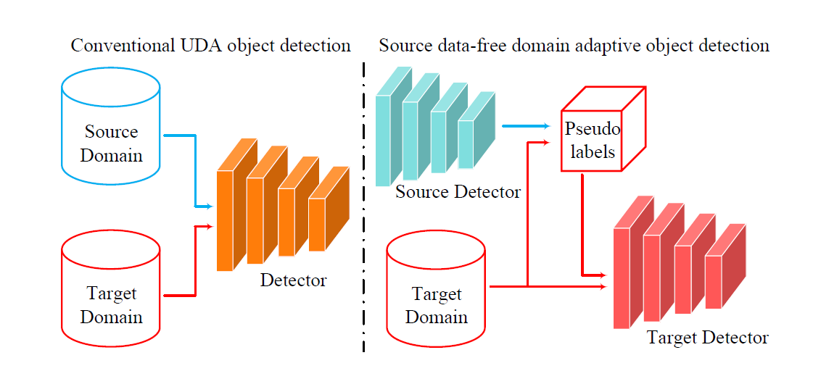
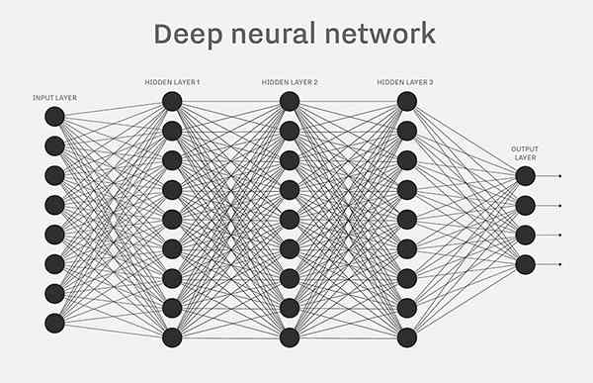

Source-free domain adaptation
源域(训练数据)
应用场景
优点：对训练过程没有要求，适用各种下游任务
缺点：模型不能应对online数据
[1] Liang, Jian, D. Hu and Jiashi Feng. “Do We Really Need to Access the Source Data? Source Hypothesis Transfer for Unsupervised Domain Adaptation.” ICML (2020).

Slide 14
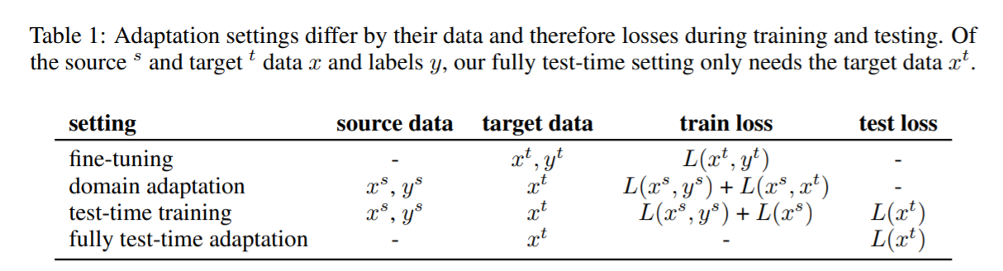
ICLR 2021: Tent: Fully Test-Time Adaptation by Entropy Minimization
Dequan Wang1∗, Evan Shelhamer2∗†, Shaoteng Liu1
, Bruno Olshausen1, Trevor Darrell1
UC Berkeley1 Adobe Research2
可以看作是Online版本的source-free DA

Slide 15
ICLR 2021: Tent: Fully Test-Time Adaptation by Entropy Minimization
Dequan Wang1∗, Evan Shelhamer2∗†, Shaoteng Liu1
, Bruno Olshausen1, Trevor Darrell1
UC Berkeley1 Adobe Research2
Motivation: 和问题相关的自监督学习任务; 利用数据的统计信息
Hint/Insight: Entropy和学习任务的error和shift相关。BN层存储模型统计信息
Method: 熵最小化作为自监督任务；更新模型的BN层参数
可以看作是Online版本的source-free DA

Slide 16
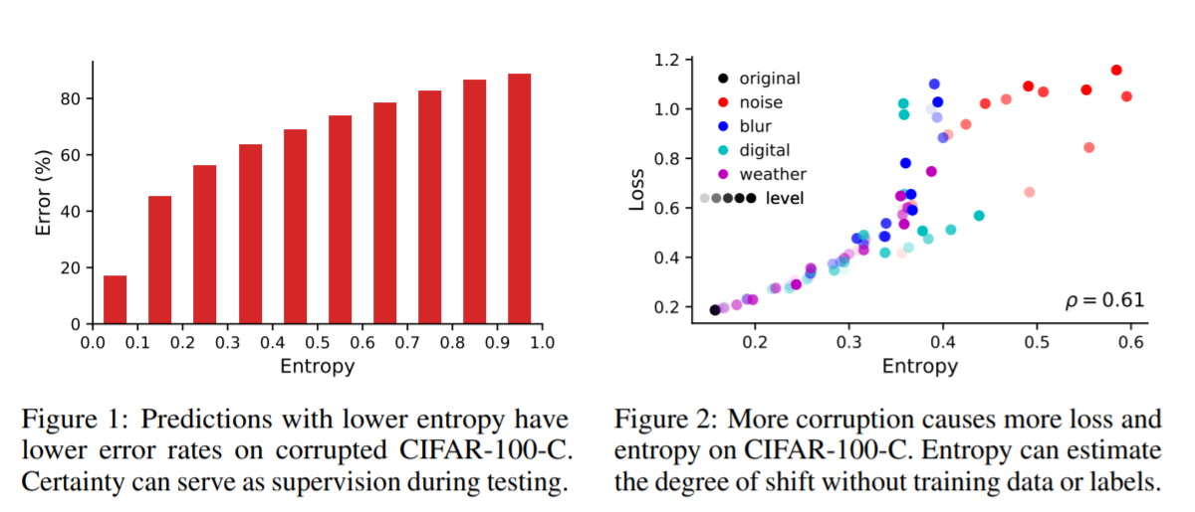
ICLR 2021: Tent: Fully Test-Time Adaptation by Entropy Minimization
Entropy is related to error and shifts

Slide 17
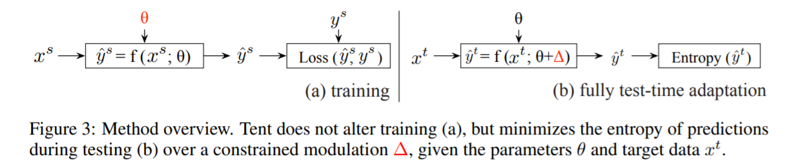
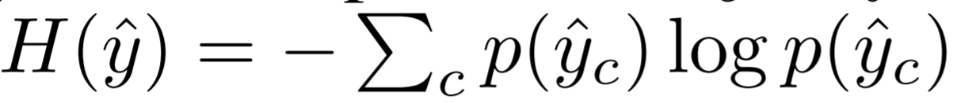
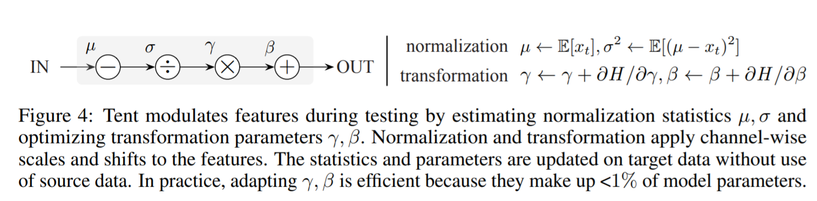
ICLR 2021: Tent: Fully Test-Time Adaptation by Entropy Minimization
Loss:
可学习参数:

Slide 18
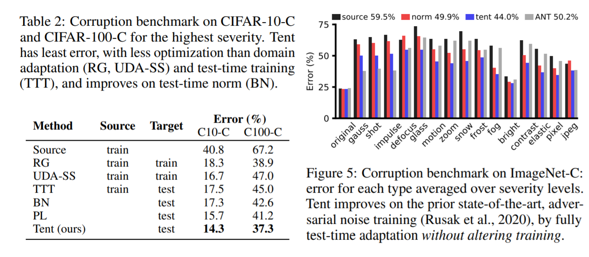
ICLR 2021: Tent: Fully Test-Time Adaptation by Entropy Minimization

Slide 19
总结
UDA在面向实际应用时存在一些局限，需要一些更加实际的setting,
比如DG, SFDA, test-time adaptation, Fine-tune等

